Slide 1
CHAPTER 03 · CONCEPTS OF ECONOMICS
Macroeconomics
Concepts
National Income • Business Cycle • Inflation • Monetary Policy • Fiscal Policy
Lecture 05 – 06

Slide 2
What We'll Cover
01
National Income
GDP, NDP and GNP — measuring what a nation produces
02
Business Cycle
The rhythm of expansion, peak, recession and recovery
03
Inflation
Types, causes, and how India tracks rising prices
04
Monetary Policy
How the RBI manages money, credit and interest rates
05
Fiscal Policy
Government spending, taxation and the Union Budget
Concepts of Economics
1

Slide 3
INTRODUCTION
What Is Macroeconomics?
Macroeconomics studies the economy as a whole — not a single firm or household, but the combined behaviour of all of them together.
MICRO vs MACRO
Microeconomics
A single consumer, a single firm, one market — e.g. why onion prices rise in one market.
It looks at aggregates: total output, total employment, the general price level.
It asks how national income, money supply, and government policy interact.
Key questions: Why do economies grow? Why does inflation rise? Why does unemployment persist?
Macroeconomics
The whole Indian economy — e.g. why overall CPI inflation rose to 4.38% in June 2026.
Introduction
2

Slide 4
THE BIG PICTURE
Components of Macroeconomics
₹
⟳
%
National Income
Business Cycle
Inflation
GDP, NDP, GNP — what the economy produces
Boom, slowdown, recession, recovery
The rate at which the general price level rises
◎
⇄
⚖
Money & Banking
External Sector
Public Finance
Money supply, credit and the RBI
Trade, exchange rate, balance of payments
Government spending, taxes, fiscal deficit
Introduction
3

Slide 5
WHY GOVERNMENTS WATCH THESE NUMBERS
Macroeconomic Concerns
1
Economic Growth
Sustained rise in real GDP and living standards
2
Price Stability
Keeping inflation low and predictable
3
Full Employment
Absorbing the workforce productively
4
External Balance
Healthy trade and stable exchange rate
5
Equitable Distribution
Narrowing income and wealth gaps
Introduction
4

Slide 6
01
National Income
GDP · NDP · GNP — measuring the size of an economy
Macroeconomics Concepts
5

Slide 7
FUNDAMENTAL CONCEPTS · NATIONAL INCOME
Gross Domestic Product (GDP)
The total market value of all final goods and services produced within a country's borders in a given period — regardless of who owns the means of production.
INDIA IN CONTEXT
8.2%
THE EXPENDITURE APPROACH
India's real GDP growth, Q2 FY 2025–26 — a six-quarter high, driven by strong domestic consumption.
GDP = C + I + G + (X − M)
C — Private consumption expenditure
I — Gross investment by businesses
G — Government expenditure
X − M — Net exports (exports minus imports)
The RBI has since revised its full-year FY 2025–26 growth forecast upward to 7.4%.
National Income
6

Slide 8
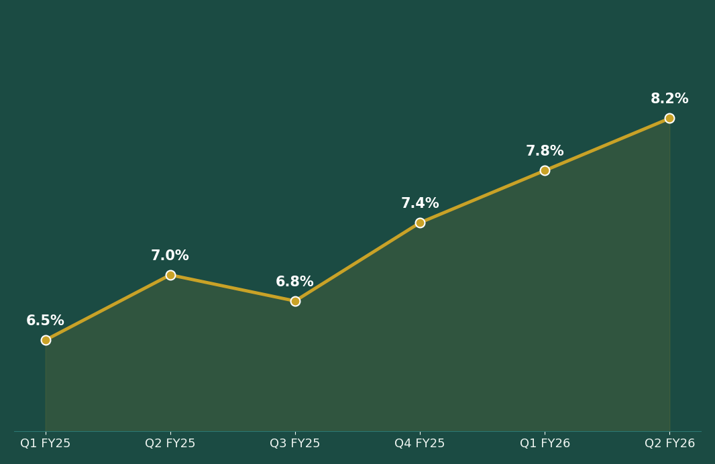
FUNDAMENTAL CONCEPTS · NATIONAL INCOME
India's GDP Growth — A Recent Trend
TREND
Growth accelerated across three straight quarters, reaching an eight-quarter high.
Private consumption and government capital expenditure were the main drivers.
Inflation stayed moderate for most of the period, giving the RBI room to cut rates.
A growing GDP raises tax revenue, supports the Union Budget, and expands the base for fiscal policy.
National Income
7

Slide 9
FUNDAMENTAL CONCEPTS · NATIONAL INCOME
Net Domestic Product (NDP)
Every year, machines, buildings and equipment wear out. NDP adjusts GDP for this wear and tear — capturing what the economy truly added, after replacing what was used up.
NDP = GDP − Depreciation (Capital Consumption Allowance)
Why it matters
Indian example
A country can show GDP growth while its factories and roads quietly decay. NDP reveals whether output growth is genuinely sustainable.
India's National Statistical Office publishes NDP alongside GDP every year in the National Accounts Statistics — used to assess infrastructure upkeep and capital stock health.
National Income
8

Slide 10
FUNDAMENTAL CONCEPTS · NATIONAL INCOME
Gross National Product (GNP)
GDP counts output produced within a country's borders. GNP instead counts output produced by a country's residents and citizens — wherever in the world they are working.
GNP = GDP + Net Income from Abroad
$135 billion+
Why GNP > GDP for India
Millions of Indians working in the Gulf, the US and elsewhere send earnings home. This income counts toward India's GNP even though it wasn't produced on Indian soil — which is why India's GNP typically exceeds its GDP.
Remittances received by India in a recent year — the world's largest recipient
National Income
9

Slide 11
02
Business Cycle
The recurring rhythm of expansion and contraction
Macroeconomics Concepts
10

Slide 12
FUNDAMENTAL CONCEPTS
Phases of the Business Cycle
▲
◆
▼
●
↗
Expansion
→
Peak
→
Recession
→
Trough
→
Recovery
Output, employment and income rise steadily
Growth tops out; capacity is fully utilised
Output, income and employment contract
Activity bottoms out at its lowest point
The economy turns upward again
Indian example: the sharp Covid-19 contraction of FY 2020–21 (recession) was followed by a strong V-shaped recovery, culminating in the 8%+ growth phase seen through 2025–26 — a textbook business cycle.
Business Cycle
11

Slide 13
03
Inflation
Why prices rise, and how India measures it
Macroeconomics Concepts
12

Slide 14
FUNDAMENTAL CONCEPTS · INFLATION
What Is Inflation?
A sustained increase in the general price level — equivalently, a sustained fall in the purchasing power of money. A little more money buys a little less each year.
INDIA, JUNE 2026
4.38%
CPI inflation (year-on-year) — the highest reading since December 2024, up from 3.93% in May.
HOW IT IS MEASURED
CPI (Consumer Price Index) — tracks retail prices of a household's basket of goods and services; India's primary inflation gauge since 2013.
WPI (Wholesale Price Index) — tracks prices at the wholesale/producer level.
Both compare current prices to a fixed base year to compute the % change.
Driven by a rebound in food prices (5.32%) — notably a sharp spike in tomato and ginger prices — and rising transport costs.
Inflation
13

Slide 15
FUNDAMENTAL CONCEPTS · INFLATION
How Is the Inflation Rate Calculated?
Inflation is measured by comparing the price index in the current period to the price index in the previous period, expressed as a percentage change.
INDIA CPI
CPI, May 2026: 105.91
CPI, June 2026: 107.15
Rate of Inflation (t) =
Pt − Pt−1
──────────
Pt−1
× 100
(107.15 − 105.91) / 105.91 × 100 ≈ 1.17% month-on-month
4.38%
Pt = price index (CPI/WPI) in the current period
Pt−1 = price index in the previous, comparable period
is the year-on-year figure MoSPI actually reported for June 2026, comparing against June 2025.
Inflation
14

Slide 16
FUNDAMENTAL CONCEPTS · INFLATION
Types of Inflation — By Speed (I)
↓
Deflation
Prices are actually falling — the purchasing power of money rises.
2-3%
Creeping Inflation
A mild, manageable rise of 2–3% a year.
3-4%
Walking Inflation
A faster annual rise of 3–4% — starting to draw attention.
Inflation
15

Slide 17
FUNDAMENTAL CONCEPTS · INFLATION
Types of Inflation — By Speed (II)
20-100%
Galloping Inflation
10³⁺%
Hyperinflation
Prices rise 20%–100% a year. It distorts relative prices and redistributes purchasing power unevenly across income groups.
Prices spiral out of control — a thousand, a million, even a billion percent a year. Usually triggered by war, political collapse, or loss of confidence in the currency.
Recent example: Argentina saw annual inflation exceed 100% in 2023–24 before recent disinflation efforts.
Classic case: Germany, 1920–23. Modern cases: Zimbabwe (2008) and Venezuela (2018), where prices doubled every few days.
Inflation
16

Slide 18
FUNDAMENTAL CONCEPTS · INFLATION
Types of Inflation — By Cause
D
C
S
Demand-Pull Inflation
Cost-Push Inflation
Stagflation
Prices rise because demand outpaces supply — too much money chasing too few goods.
Prices rise because production costs — wages, raw materials, imports — keep climbing.
The worst mix: stagnant growth, high unemployment and high inflation all at once.
Inflation
17

Slide 19
FUNDAMENTAL CONCEPTS · INFLATION
What Drives These Two Forces?
DEMAND-SIDE FACTORS
SUPPLY-SIDE (COST) FACTORS
Rising disposable income and consumer spending
Tax cuts (direct or indirect) that boost demand
A depreciating rupee raising import demand pressure
Rising cost of imported raw materials, e.g. crude oil
Rising labour and wage costs
Higher indirect taxes imposed by the government
Inflation
18

Slide 20
FUNDAMENTAL CONCEPTS · INFLATION
Effects of Inflation — Who Wins, Who Loses
HURT BY INFLATION
HELPED BY INFLATION
Savers and fixed-deposit holders — real returns shrink
People on fixed incomes, e.g. pensioners
Lenders repaid in money worth less than when lent
Exporters, if domestic costs rise faster than global prices
Borrowers — loans are repaid in cheaper money
Asset owners — property and equity prices often rise with inflation
The government — tax revenue rises with nominal incomes and prices
Producers holding inventory, if selling prices rise faster than costs
Inflation
19

Slide 21
04
Monetary Policy
How the RBI steers money, credit and interest rates
Macroeconomics Concepts
20

Slide 22
MONETARY POLICY
What Is Monetary Policy?
The process by which a country's monetary authority — in India, the Reserve Bank of India (RBI) — controls the supply of money and the cost of credit, typically by targeting interest rates, to promote economic growth and stability.
RBI Actions
Liquidity
Aggregate Demand
Interest rates, money supply, credit availability
→
Cost and availability of credit shift across the economy
→
Spending, investment and prices respond
Monetary Policy
21

Slide 23
MONETARY POLICY
Credit Policy & the RBI's Role
In modern economies, most money exists as bank deposits, not currency and coins — so controlling credit matters as much as controlling cash.
The RBI can act directly, controlling money supply growth itself, or indirectly, influencing the cost and availability of credit through banks.
Today, the RBI guides monetary developments through instruments that shape deposit creation and overall financial conditions.
The RBI administers both monetary policy and credit policy — they are two arms of the same institution, working together.
Monetary Policy
22

Slide 24
MONETARY POLICY
Objectives of Monetary Policy
Price Stability
Full Employment
Stable Exchange Rate
1
2
3
Economic Growth
Equitable Income Distribution
Financial Stability
4
5
6
PRICE STABILITY — the dominant objective
The RBI's inflation target is 4% CPI inflation, within a tolerance band of 2%–6%. It doesn't mean prices freeze — it means avoiding both runaway inflation and deflation over the long run, which in turn stabilises interest rates, the exchange rate and living standards.
Monetary Policy
23

Slide 25
MONETARY POLICY
Instruments of Monetary Policy
QUANTITATIVE
QUALITATIVE / SELECTIVE
Control the total volume of money and credit in the economy — apply uniformly across all sectors.
Target specific sectors or types of lending, rather than the whole money supply.
Open Market Operations (OMO)
Bank Rate
Repo & Reverse Repo Rate
Cash Reserve Ratio (CRR) & SLR
Credit Rationing
Margin Lending Requirements
Moral Suasion
Monetary Policy
24

Slide 26
MONETARY POLICY · INSTRUMENT 1
Open Market Operations (OMO)
OMOs are the RBI's buying and selling of government securities in the open market, to or from banks and the public.
Selling securities
Buying securities
When inflation is high, the RBI sells securities to mop up excess money from the market — reducing liquidity.
To increase the money supply and support growth, the RBI purchases securities — injecting liquidity into the system.
Monetary Policy
25

Slide 27
MONETARY POLICY · INSTRUMENT 2
Bank Rate
The rate of interest the RBI charges for lending funds to the banking system — without any sale of securities, unlike repo.
CURRENT BANK RATE
5.50%
Raising the Bank Rate raises the cost of borrowing for commercial banks.
This reduces the volume of credit banks extend, and slows money supply growth.
Markets read a Bank Rate hike as the RBI's official signal of tightening conditions.
As set by the RBI, effective June 2026 — aligned with the Marginal Standing Facility (MSF) rate.
Monetary Policy
26

Slide 28
MONETARY POLICY · INSTRUMENT 3
Repo & Reverse Repo Rate
REPO RATE
REVERSE REPO RATE
5.25%
3.35%
The rate at which the RBI lends short-term funds to commercial banks against government securities as collateral.
The rate at which the RBI borrows funds from commercial banks — banks park surplus funds with the RBI for a short period.
Held steady at 5.25% through the June 2026 MPC meeting, after being cut from 5.50% in December 2025.
It sits below the repo rate, forming a corridor that keeps short-term interbank rates in a stable range.
Monetary Policy
27

Slide 29
MONETARY POLICY · INSTRUMENT 4
Reserve Ratios: CRR & SLR
CASH RESERVE RATIO (CRR)
STATUTORY LIQUIDITY RATIO (SLR)
3.00%
18.00%
The share of a bank's deposits that must be kept with the RBI, in cash — earning no interest. It directly controls how much banks can lend.
The minimum share of deposits a bank must hold in liquid assets — cash, gold, or approved government securities.
A CRR or SLR hike locks up more bank funds, shrinking lendable resources and cooling credit growth; a cut frees up funds for lending.
Monetary Policy
28

Slide 30
MONETARY POLICY · INSTRUMENT 5
Selective Credit Controls
Credit Rationing
Margin Lending
Moral Suasion
The RBI fixes a ceiling on loans and advances for certain categories, ensuring credit reaches all sectors — vital for inclusive growth.
A loan that lets a borrower invest using existing shares, mutual funds, or cash as security.
Persuasion rather than compulsion — the RBI nudges banks toward its policy goals through meetings, speeches and seminars.
Monetary Policy
29

Slide 31
05
Fiscal Policy
Government spending and taxation as tools for the economy
Macroeconomics Concepts
30

Slide 32
FISCAL POLICY
What Is Fiscal Policy?
The word 'fisc' means state treasury. Fiscal policy is the use of government spending and taxation to achieve macroeconomic goals — any decision to change the level or composition of government expenditure, or the burden and structure of taxes, is fiscal policy.
Two main instruments: Government Expenditure & Taxation
INDIAN EXAMPLE — GST REFORM
India's GST rate rationalisation (2025) simplified indirect tax slabs to boost consumption — a direct, textbook use of the taxation arm of fiscal policy, credited by the OECD with supporting growth and easing food-price inflation.
Fiscal Policy
31

Slide 33
FISCAL POLICY
Fiscal Policy & Macroeconomic Goals
1
Growth
Creating conditions for higher savings and investment
2
Employment
Encouraging labour-absorbing technology and sectors
3
Stabilisation
Fighting both depression and overheating
4
Equality
Narrowing income and wealth gaps
5
Price Stability
Containing both inflationary and deflationary pressure
Fiscal Policy
32

Slide 34
FISCAL POLICY
Government Spending & Aggregate Demand
Aggregate demand — the total demand for goods and services in the economy — depends on three main variables: consumption, private investment, and government spending.
↑ Government spends more
↓ Government spends less
Aggregate demand rises → stimulates output, growth and employment across the economy.
Aggregate demand falls → slows output growth and can cool an overheating economy.
Fiscal Policy
33

Slide 35
FISCAL POLICY
Deficit, Surplus & Policy Stance
Fiscal Deficit
Fiscal Surplus
Government expenditure exceeds its revenue — the more common Indian scenario, financed through borrowing.
Revenue exceeds expenditure — the reverse situation, relatively rare for the Indian government.
Expansionary Policy
Contractionary Policy
Cut taxes, raise spending — used to pull the economy out of a slowdown.
Raise taxes, cut spending — used to rein in inflationary pressure.
Fiscal Policy
34

Slide 36
BRINGING IT TOGETHER
Recap: The Five Pillars
1
National Income
GDP, NDP and GNP measure the size and health of the economy — India's GDP grew 8.2% in Q2 FY 2025–26.
2
Business Cycle
Every economy moves through expansion, peak, recession and recovery — as India did post-Covid.
3
Inflation
A sustained rise in prices, currently 4.38% CPI in India (June 2026), tracked via CPI and WPI.
4
Monetary Policy
The RBI manages money and credit via repo (5.25%), CRR (3.00%) and SLR (18.00%).
5
Fiscal Policy
Government taxation and spending — from GST reform to the Union Budget — steer aggregate demand.
Recap
35

Slide 37
CHECK YOUR UNDERSTANDING
Quick Quiz — Part 1
Q1.
GDP is calculated using the formula:
A) C + I + G + (X − M) B) C − I + G C) I + G − T D) C + S + T
Q2.
Which index is India's primary measure of retail inflation?
A) WPI B) CPI C) SENSEX D) IIP
Q3.
An annual price rise of 20%–100% is classified as:
A) Creeping inflation B) Walking inflation C) Galloping inflation D) Deflation
Q4.
The rate at which the RBI lends to banks against government securities is the:
A) Bank Rate B) Repo Rate C) Reverse Repo Rate D) CRR
Quiz
36

Slide 38
CHECK YOUR UNDERSTANDING
Quick Quiz — Part 2
Q5.
The current Cash Reserve Ratio (CRR) set by the RBI is:
A) 18.00% B) 5.25% C) 3.00% D) 6.50%
Q6.
Stagflation refers to the simultaneous occurrence of:
A) High growth and low inflation B) Recession and deflation C) Stagnant growth, high unemployment, high inflation D) High growth and high employment
Q7.
The two main instruments of fiscal policy are:
A) Repo rate and CRR B) Government expenditure and taxation C) OMOs and bank rate D) Exports and imports
Q8.
When government spending exceeds government revenue, this is called a:
A) Fiscal surplus B) Trade deficit C) Fiscal deficit D) Current account surplus
Quiz
37

Slide 39
ANSWER KEY
A
Q1
B
Q2
C + I + G + (X − M)
CPI — Consumer Price Index
C
Q3
B
Q4
Galloping inflation
Repo Rate
C
Q5
C
Q6
3.00%
Stagnant growth, high unemployment, high inflation
B
Q7
C
Q8
Government expenditure and taxation
Fiscal deficit
Quiz
38

